Slide 1

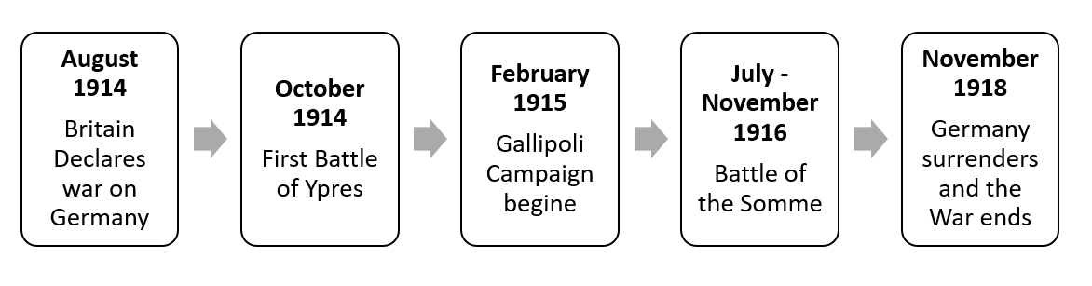
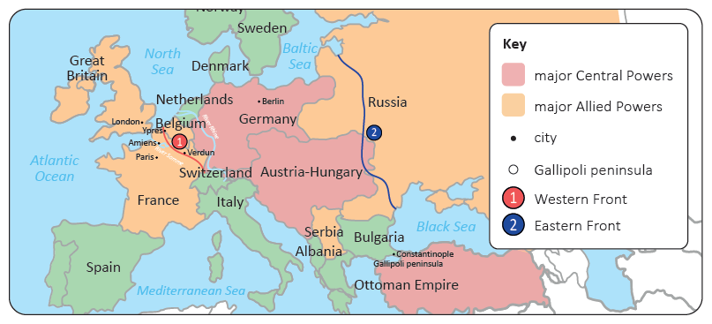
Year 6 | Subject: History | Unit Title: Britain at War 1 | Unit Title: The Amazon
Knowledge statements: I can order and summarise key events during this historical period using timelines. I can identify and discuss the countries and key individuals involved. I can identify the impact of the war on my local area during and after the war. I can use a range of evidence from different sources to research and describe key events. I can use dates when describing key events.
 |  |  |  | We are Historians: We can put historical events in chronological order. We can ask thoughtful questions –why did children need to be evacuated? What was the experience of being an evacuee like? We can think critically – why did World War II start? What were the most significant factors?
Key vocabulary: alliance A group of countries who have agreed to work together because of shared aims. appeasement Giving the opposing side something they have demanded to prevent further disagreement. colony A nation controlled by another country. conscription Forcing people by law to join the armed services. genocide The deliberate killing of large numbers of people from a particular nation or ethnic group, with the aim of destroying that nation or group. imperialism The desire to conquer and colonise other countries. militarism The belief that it is necessary to build up and use strong armed forces to gain power, money and land. reparation Payment made by a defeated country after a war to pay for damages it caused to another country. stalemate A situation in which neither side can get an advantage, and no action can be taken. |  |  | Timeline:

