Slide 1

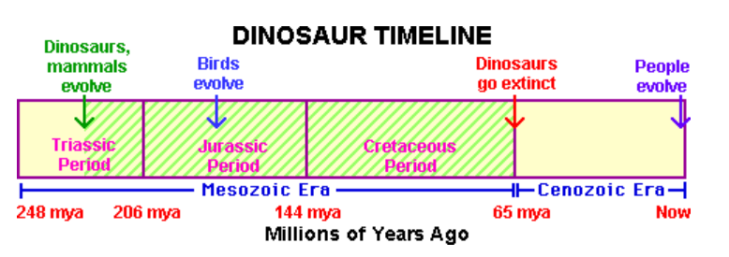
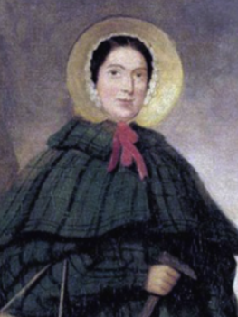
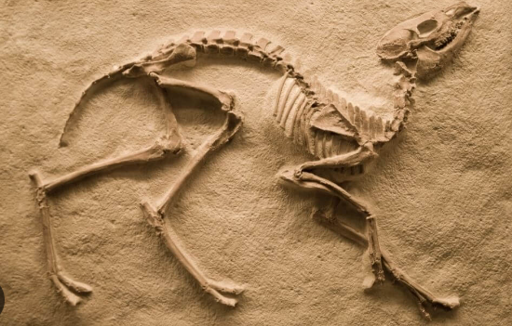
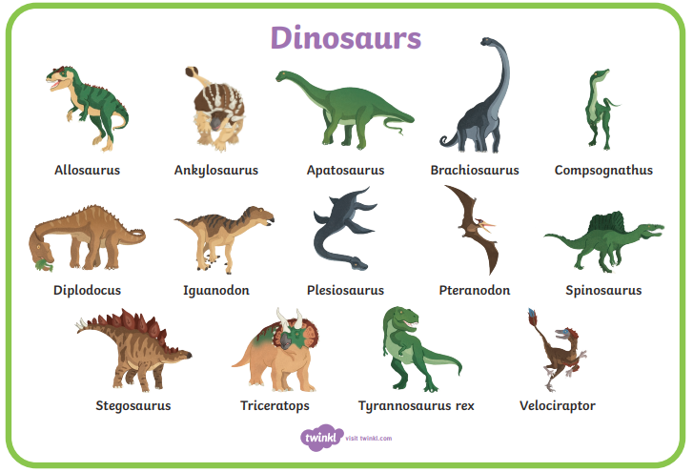
Year 1 | Subject: History | Unit Title: Dinosaurs | Unit Title: The Amazon
Knowledge statements: I know that Mary Anning was a famous fossil hunter. I can place the events of the dinosaurs in chronological order. I can talk about why the dinosaurs became extinct. I know that fossils can tell us about the past.
 |  |  |  | We are Historians: We can put historical events in chronological order. We can use common words and phrases to speak about the past. We can talk about significant historical people.
Key vocabulary: Fossils- Fossils are the preserved remains of plants and animals whose bodies were buried Palaeontologists - A scientist that studies history through fossils Dinosaurs - animals with upright limbs that lived on land during the Mesozoic Era (252 to 66 million years ago). Carnivore – animal that only eats meat. Herbivore – animal that only eats plants Omnivore – animal that eats both plants and meat. Extinction – permanent disappearance of a species- no more exist.
 |  |  | Mary Anning was a fossil hunter.. |  | Fossils have helped us learn more about the dinosaurs.

