Slide 1

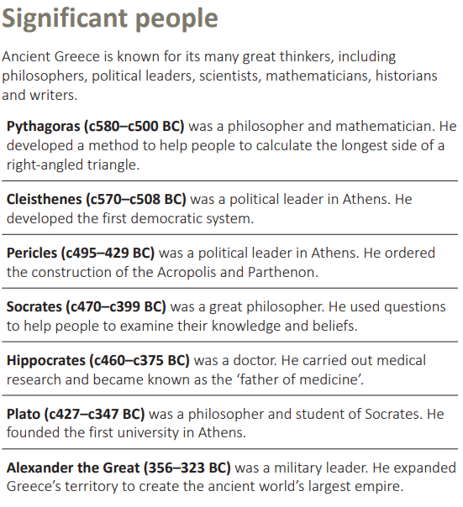
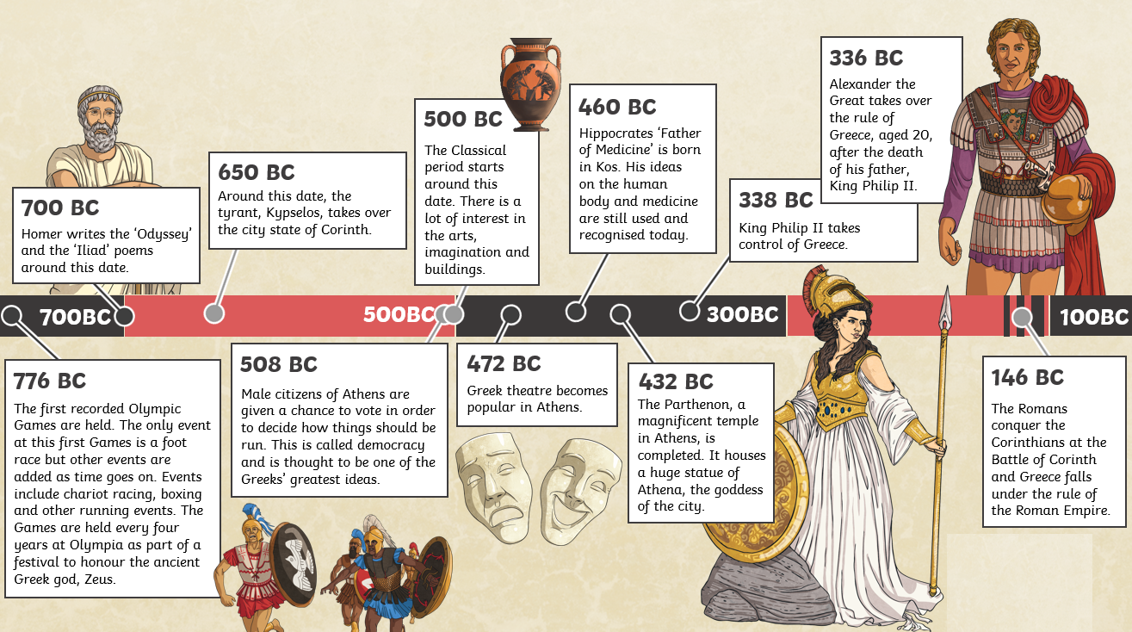
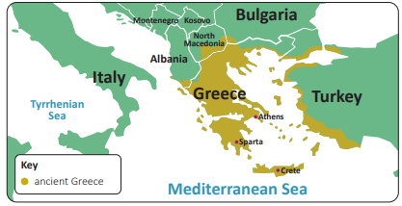
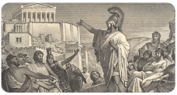
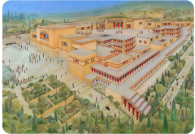
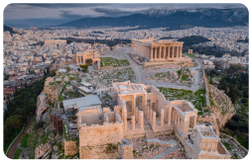
Year 5 | Subject: History | Unit Title: Ground-breaking Greeks | Unit Title: The Amazon
Knowledge statements: I can study Greek life and achievements and their influence on the western world (Ancient Greece). I can order and summarise key events during this historical period using timelines. I can compare what life was like in Ancient Greek to life today. I can identify key gods and goddesses in the Ancient Greek Culture. I can explain the key characteristics of the Athenians and the Spartans. I can explain how the Olympics began and how it has influences modern day Olympics.
 |  |  |  | We are Historians: We can put historical events in chronological order. We can use common words and phrases to speak about the past. We can talk about significant historical people.
Timeline: |  |  | Key vocabulary:
 |  |  | Acropolis: The upper fortified area of a Greek city that is usually built on a hill. Athenian: A person from Athens Citadel: A central fortified area of city or town. City state: A city and the area surrounding it with an independent government. Civilisation: A high developed culture, including its social organisation, government, laws and arts. Democracy: A political system, which allows people to have a say in the way their country is governed. Empire: A group of countries or states ruled by a single authority, such as an emperor or monarch. Mythology: A collection of religious and cultural stories. Parthenon: A temple on the Acropolis in Athens. Warrior: A soldier with skill and experience in fighting.

