Slide 1

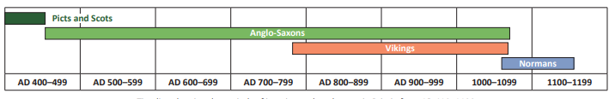
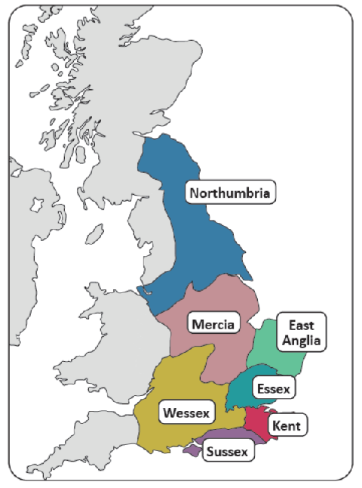
Year 4 | Subject: History | Unit Title: Invasion | Unit Title: The Amazon
 |  |  |  | We are Historians: To develop chronological knowledge and understanding of British, local and world history. To note connections, contrasts and trends in history. To know our knowledge of the past is devised from a range of sources.
Key vocabulary: Conquer – Overcome and take control of a place or people. Invasion – When a foreign army enters a country by force. Raid – A sudden attack with aims to cause damage. Anglo-Saxons (Jutes)- Foreigners who lived in England and Wales during the 5th Century. Celt – People who lived in Britain during the Iron Age. Hierarchy – System of ranking and organising people or things. Norman – A group of people who descended from Norwegian Vikings. Viking – People who travelled from Scandinavia to Britain. Trader – Someone who buys or sells goods. |  |  | Timeline:
 |  |  |  |  | After the Romans left Britannia in AD 410, many towns fell into disrepair and the country became vulnerable to attack. This marked the beginning of a period of invasions from different groups: Picts and Scots from Scotland and Ireland; Anglo-Saxons from Germany, the Netherlands and Denmark; Vikings from Scandinavia and Normans from France. This time in history is called the early Middle Ages.
Knowledge statements:
I know about life in Britain after the Roman withdrawal.
I know about significant invasions that happened in Britain including Anglo-Saxon and Viking invasions.
I know the causes and consequences that occurred due to the different invasions.
I can name significant people from the Anglo-Saxon and Viking time periods.
I can use a timeline to order events into chronological order.
I can compare everyday life in contrasting time periods.
The heptarchy

