Slide 1

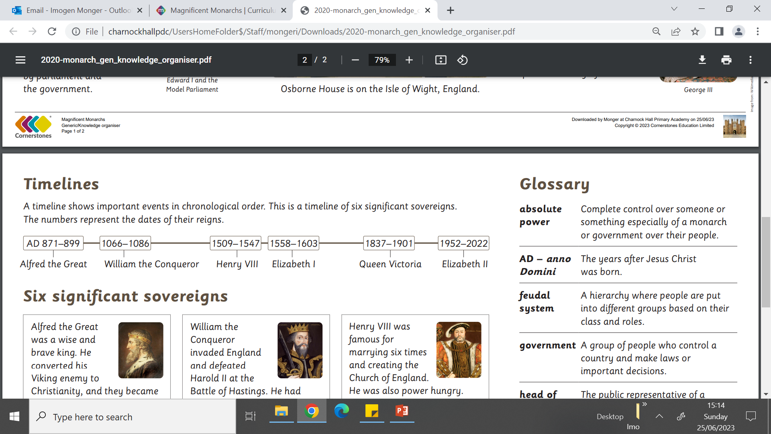
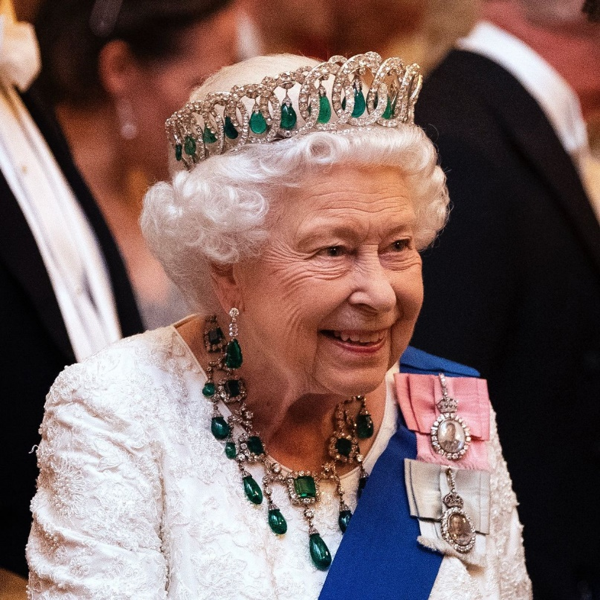
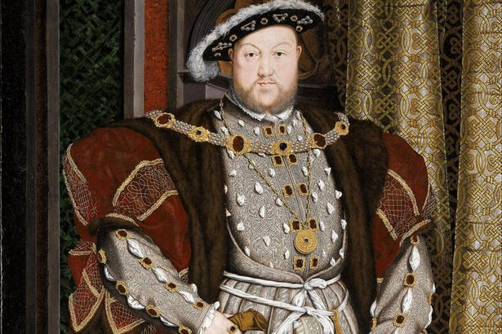
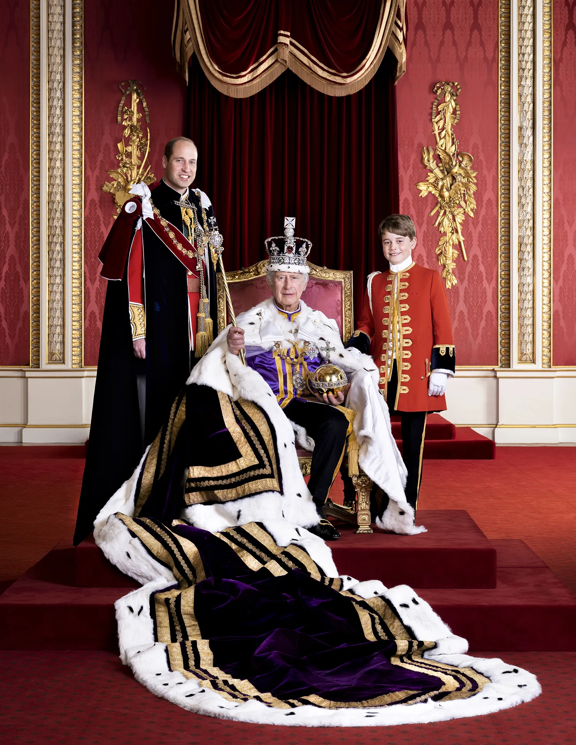
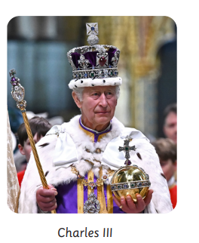
Year 2 | Subject: History | Unit Title: Magnificent Monarchs | Unit Title: The Amazon
Knowledge statements: I know why monarchs have had a major impact on the world. I can study the life and impact of a range of significant monarchs. I know how to use a timeline to put events, people and objects in chronological order. I can name, locate and explain the significance of a place (Buckingham Palace). I can describe how people, places and events in my own locality have changed over time.
 |  |  |  | We are Historians: We can put historical events in chronological order. We can use common words and phrases to speak about the past. We can talk about significant historical people.
Key vocabulary: monarch - A king or queen who rules a kingdom. parliament - A group of people who make the laws for a country. reign - The period of time that a king or queen rules over a country. sovereign - A king or queen. government - A group of people who control a country and make laws or important decisions. head of state - The public representative of a country, such as monarch. hierarchy - The order of people or things from most important to least important. absolute power - Complete control over someone or something especially of a monarch or government over their people. AD – anno Domini The years after Jesus Christ was born. Monarchy in the United Kingdom: There have been over 60 monarchs since Alfred the Great in AD 871. Elizabeth II was the longest reigning British monarch until she died in 2022. The monarch today is Charles III. |  |  | Timeline: This is a timeline of six significant sovereigns.
 |  |  | Elizabeth II was the monarch and the Head of the Commonwealth for 70 years. |  | Henry VIII was famous for marrying six times and creating the Church of England.

