Slide 1

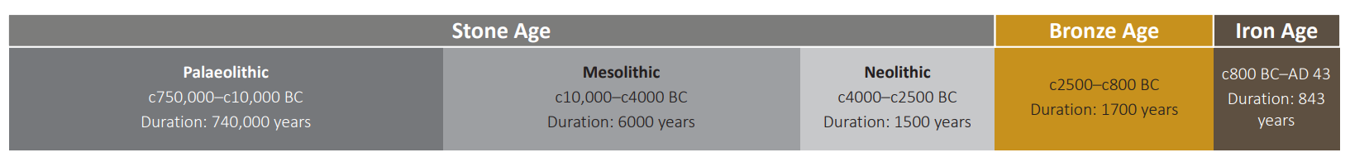
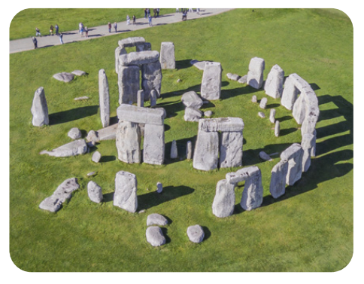
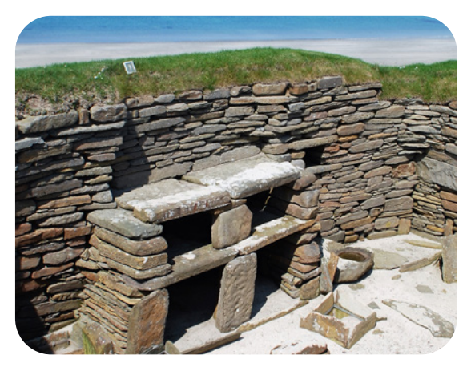
Year 3 | Subject: History | Unit Title: Through the Ages | Unit Title: The Amazon
Knowledge statements: I know how to use a timeline to put events, people and objects in chronological order. I can explain the importance of inventions and ingenuity. I know the causes and consequences of different time periods. I can compare everyday life in contrasting time periods. I know about life in pre-historic Britain.
 |  |  |  | We are Historians: We can put historical events in chronological order. We can use common words and phrases to speak about the past. We can talk about significant historical people.
Key vocabulary: Archaeologist – someone who sturdies artefacts from the past Artefacts – an object that is of historical interest Prehistoric- A time before written records. Stone Age- A period when weapons and tools were made of stone or materials like bone wood or horn. Iron Age- A period when weapons and tools were made of iron. Bronze Age- A period when weapons and tools were made of bronze. Beaker folk – A group of people who created beakers and therefore got their name from their creative creations. Hunter– gatherers – A lifestyle that relies on hunting and fishing. Nomadic- A group of people without a fixed place to live. Palaeolithic – The time period at the start of the Stone Age. Mesolithic- The time period in the middle of the Stone Age. Neolithic- The time period at the end of the Stone Age. |  |  | Timeline:
 |  |  | Stonehenge – A stone circle in Wiltshire, England. |  | Skara Brae- Neolithic settlement in the Orkney Islands, Scotland.

