Slide 1

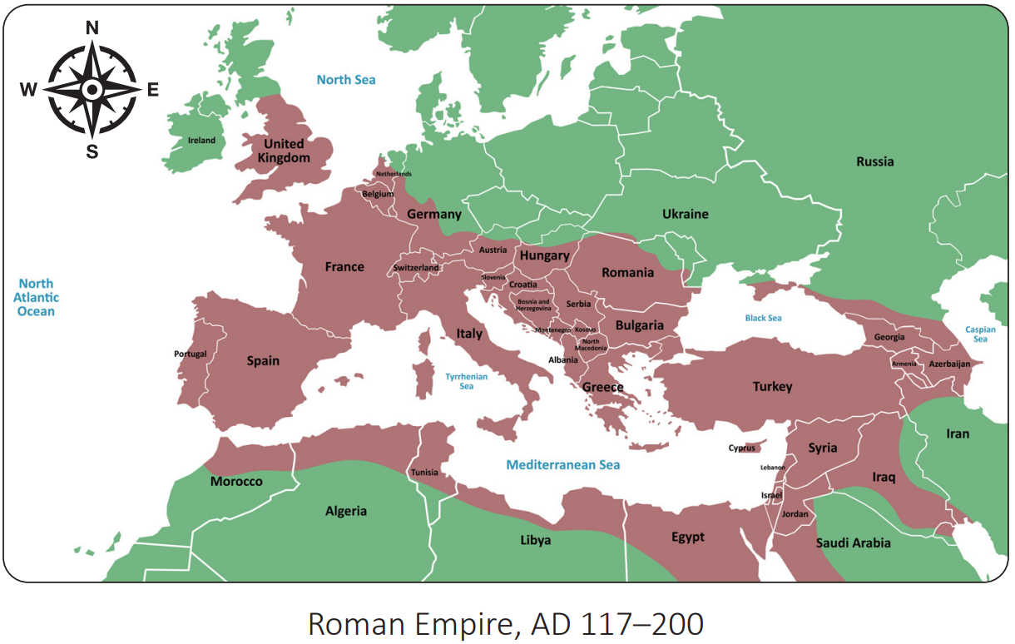
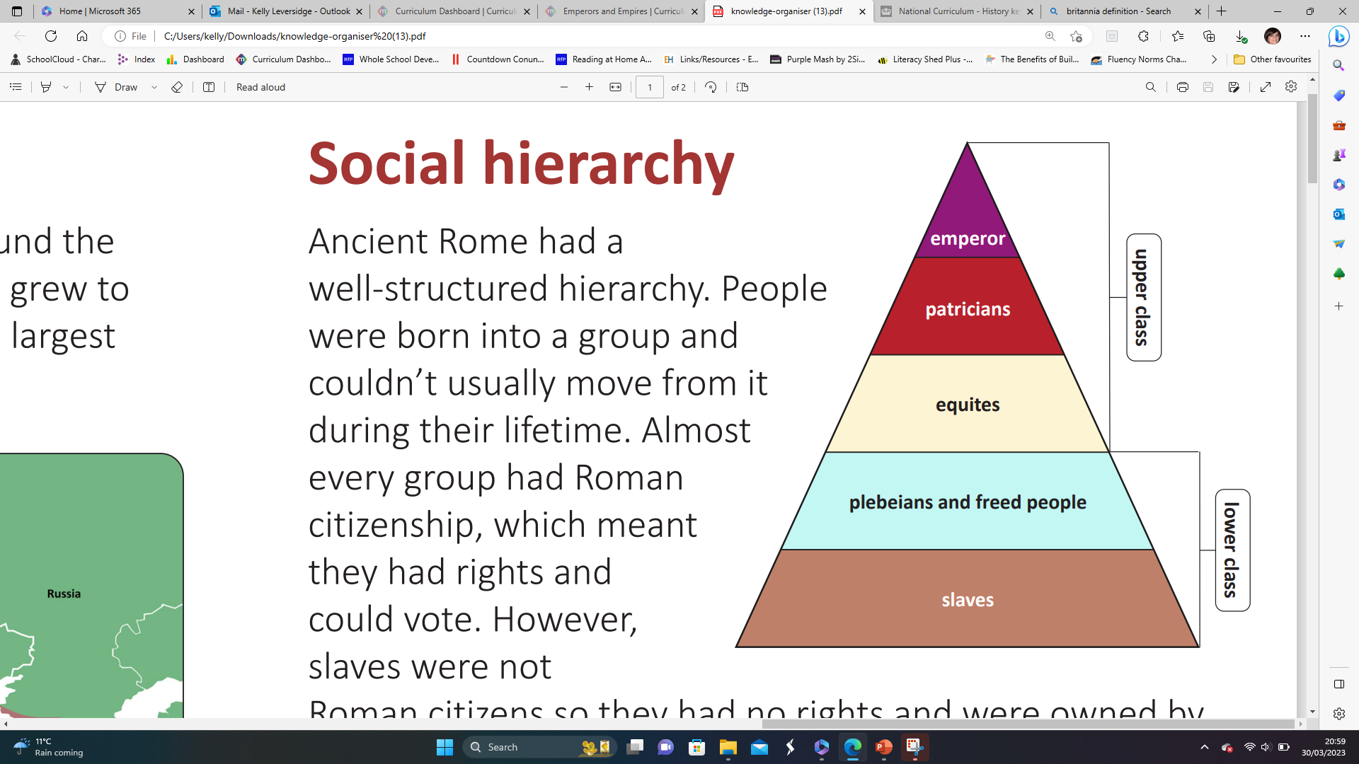
Year 3 | Subject: History | Unit Title: Emperors and Empires | Unit Title: The Amazon
Knowledge statements: I can ask historical questions about everyday life in ancient Rome. I can describe the hierarchy in ancient Rome. I understand the achievements and influence of the ancient Romans on the wider world. I can identify if someone is significant using Dawson’s model. I understand the hierarchy of the Roman army. I can describe the impact of power struggles on Britain.
 |  |  |  | We are Historians: We can ask historical questions. We understand how Britain has been influenced by the wider world. We understand hierarchy and its impact on Britain.
Key vocabulary: Britannia– Roman Britain. centurion – An officer in the Roman army who commanded an army of around 100 legionaries. consul - One of two men who held the highest position in the senate of the Roman Republic. empire - A group of countries ruled by a single person, government or country. hierarchy - A system where people or things are arranged in order of importance. invasion – Act of entering a place to take control. legionary – A soldier in a Roman army. Roman citizen - A person who had privileges and protection from the Roman state. Romanise – To become Roman. |  |  | Timeline:
Roman Britain
55-54BC – First and second invasion of Britain by Caesar
AD43 – Claudius invades and conquers Britain.
AD60-61 – Boudica rebels against Roman rule.
AD122 – Hadrian’s wall is built.
AD211 – Londinium becomes the capital of Roman Britain.
AD313 – Christianity becomes legal in the Roman Empire.
AD400 – Roman army gradually leave Britannia
AD410 – Roman rule ends.
Social hierarchy

