Slide 1

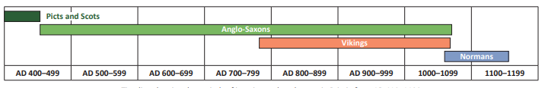
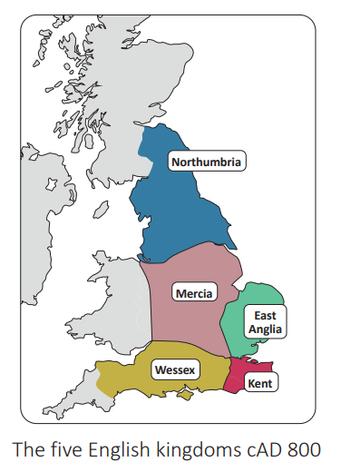
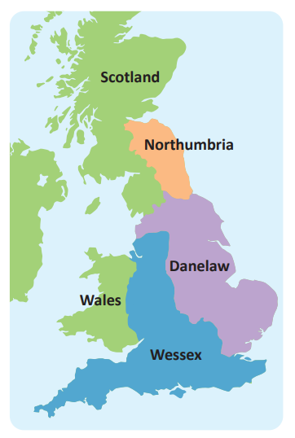
Year 4 | Subject: History | Unit Title: Invasion | Unit Title: The Amazon
Knowledge statements: I know about life in Britain after the Roman withdrawal. I know about significant invasions that happened in Britain including Anglo-Saxon invasions and Viking invasions. I know the causes and consequences that occurred due to the different invasions. I can name significant people from the Anglo-Saxon and Viking time periods. I can use a timeline to order events into chronological order. I can compare everyday life in contrasting time periods.
 |  |  |  | We are Historians: To develop chronological knowledge and understanding of British, local and world history. To note connections, contrasts and trends in history. To know our knowledge of the past is devised from a range of sources.
Key vocabulary: Conquer – Overcome and take control of a place or people. Invasion – When a foreign army enters a country by force. Raid – A sudden attack with aims to cause damage. Anglo-Saxons (Jutes)- Foreigners who lived in England and Wales during the 5th Century. Celt – People who lived in Britain during the Iron Age. Hierarchy – System of ranking and organising people or things. Norman – A group of people who descended from Norwegian Vikings. Viking – People who travelled from Scandinavia to Britain. Trader – Someone who buys or sells goods. |  |  | Timeline:
 |  |  |  |  | Alfred the Great split England into Viking Danelaw and Anglo-Saxon Wessex following the Battle of Edington in AD 876.

