Slide 1


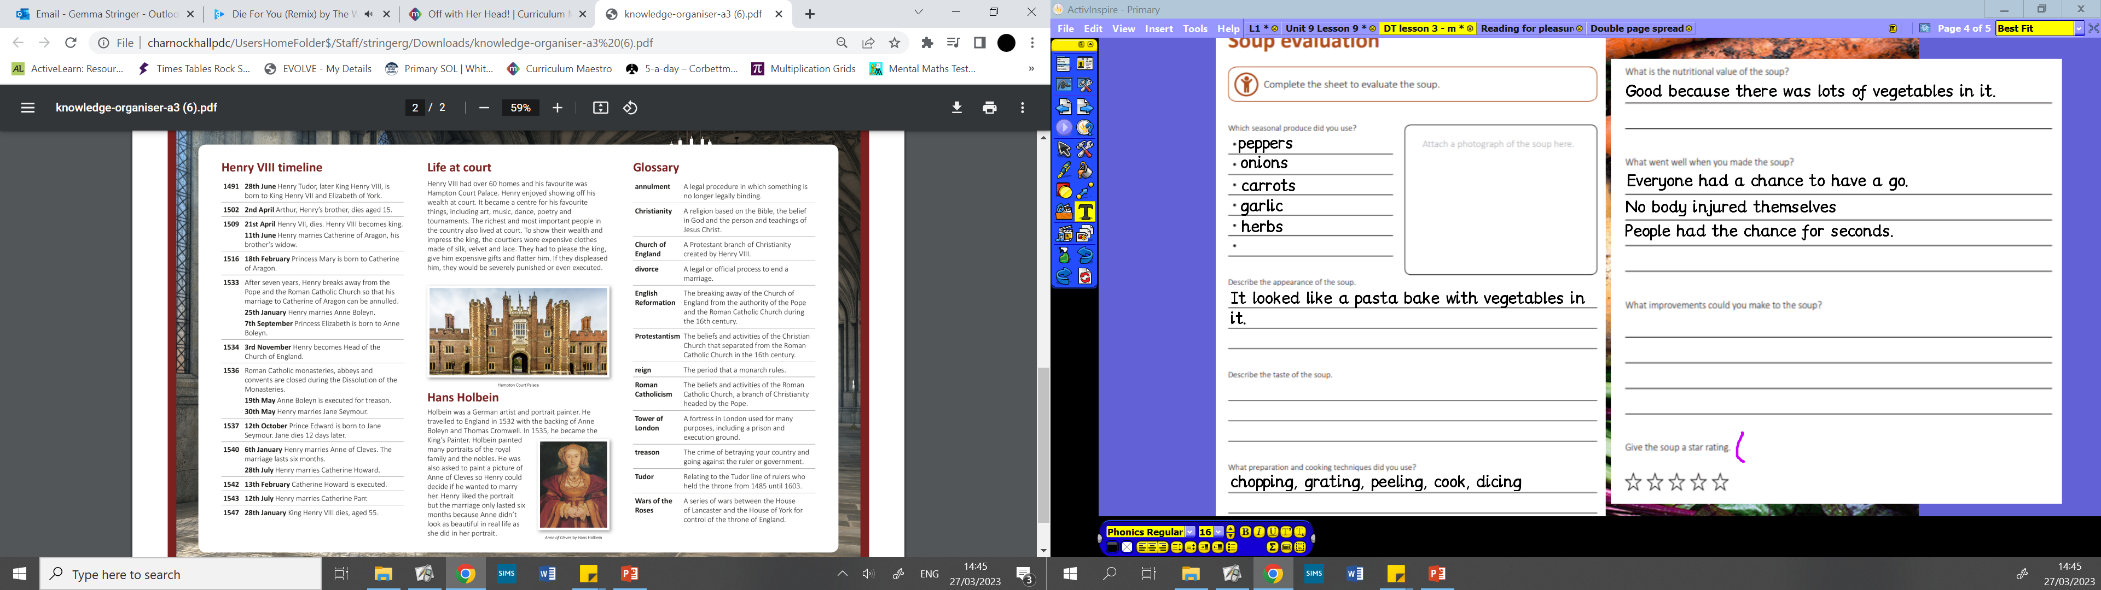
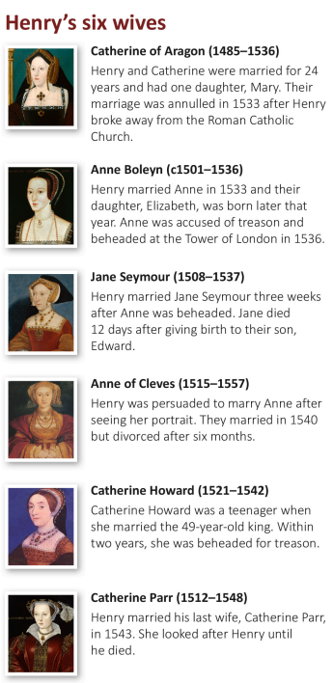
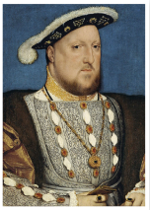
Year 5 | Subject: History | Unit Title: Off with her head! | Unit Title: The Amazon
Knowledge statements: To understand the aspects of British history include the rise, fall and actions of the monarchy; improvements in technology; exploration; disease; the lives of the rich and poor and changes in everyday life. I know how to use a timeline to put events, people and objects in chronological order. I can use historical terms including topic related vocabulary. I can gain historical perspective by understanding the connections between different periods of history. |  |  |  | We are Historians: We can make connections between different periods of history. We can use historical terms including topic related vocabulary. We can understand different aspect of British history.
Key information: The Tudor period began when Henry Tudor defeated King Richard III at the Battle of Bosworth in 1485. This ended the Wars of the Roses. Henry Tudor became King Henry VII after the battle and married Elizabeth of York in 1486. Their youngest song, Henry, went on to become King Henry VIII. He became king when he was 18 and was king from 1509 until he died in 1547. He is mostly remember for having six wives and breaking away from the Roman Catholic Church and the Pope. He was known as cruel and selfish during his reign. Key vocabulary: Reign: the period that a monarch rules. Divorce: a legal or official process to end a marriage. Treason: the crime of betraying your country or going against the ruler. Execution: the killing of a person as a legal penalty for a crime. Exile: the state of being sent away from one’s own country. Heir: a person legally entitled to the money or title of another person upon their death. Henry’s ‘ Great Matter’: a term used to refer to King Henry VIII desperation to have a son.

