Slide 1

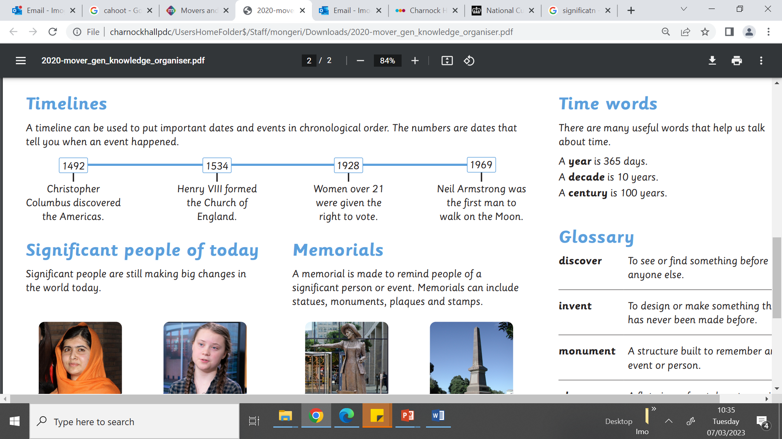
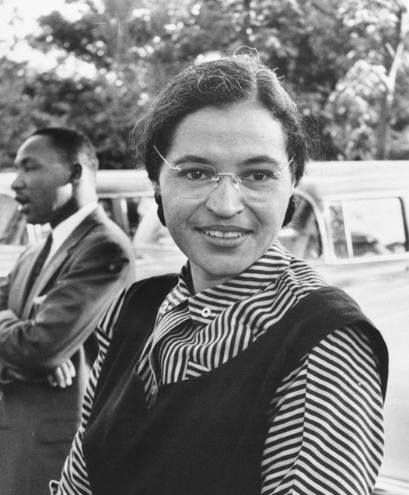
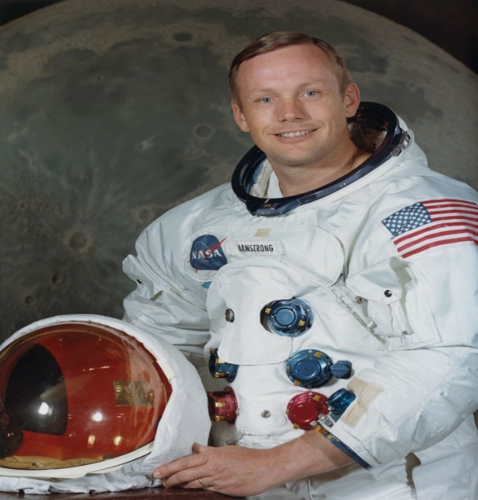
Year 2 | Subject: History | Unit Title: Movers & Shakers | Unit Title: The Amazon
Knowledge statements: I know why significant people have had a major impact on the world. I can identify if someone is significant using Dawson’s Modal. I can use the words year, decade and century to describe dates and times. I can study the life and impact of a range of significant individuals from around the world. I know how to use a timeline to put events, people and objects in chronological order.
 |  |  |  | We are Historians: We can put historical events in chronological order. We can use common words and phrases to speak about the past. We can talk about significant historical people.
Key vocabulary: discover - To see or find something before anyone else. invent - To design or make something that has never been made before. monument - A structure built to remember an event or person. significant - Something that is important. statue - An object usually made from stone or metal to look like a person. year – 365 days decade – 10 years century – 100 years Categories of significant people: An activist is a person who feels strongly about helping people, other living things or the planet. They protest to make changes happen. An explorer is a person who travels to places to find out what is there. A scientist is a person who discovers or invents new things. An artist is a person who creates works of art, including pieces of music, plays, poems, paintings, dances or sculptures. A monarch is a king or queen who rules a kingdom. |  |  | Timeline:
 |  |  | Rosa Parks wanted black people to have the same rights as white people. |  | Neil Armstrong was the first person to walk on the Moon.

