Slide 1

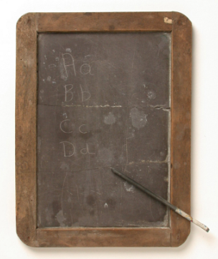
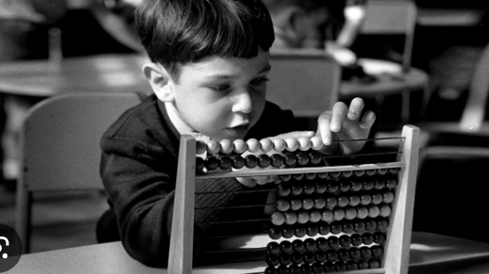
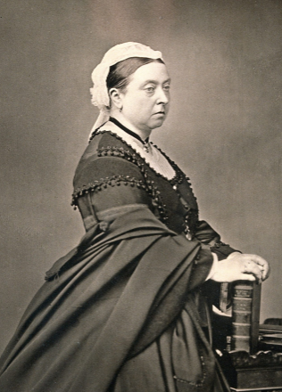
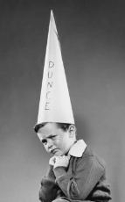
Year 1 | Subject: History | Unit Title: School Days | Unit Title: The Amazon
Knowledge statements: I know that Queen Victoria was Queen during the Victoria Era. I know schools were different in the Victorian Era compared to now. I know Samuel Wilderman is famous for his work on education. I know that places change over time and can compare how they have changed.
 |  |  |  | We are Historians: We can put historical events in chronological order. We can use common words and phrases to speak about the past. We can talk about significant historical people.
Key vocabulary: Dunce’s hat - A cone-shaped hat with a letter D on the front, which was worn by children in the Victorian era as a punishment. Chronology - The order in which events happened Monarch - A king or queen who rules a kingdom Centenary - The 100 year anniversary of a place or event. Cane - A long piece of wood or bamboo that was used to punish children in the Victorian era. Invention - Something new that has never been made before. Victoria Schools In Victorian schools, boys and girls were separated. Children sat in rows and copied letters and numbers from a blackboard onto slate boards. Teachers were strict and used the dunce’s cap and the cane to punish children. Reading, writing and arithmetic, the three Rs, were the most important lesson alongside religious instruction. There were no school dinners, so children went home at lunchtime.
 |  |  | Queen Victoria was queen during the Victorian Era in Britain. |  | The Dunces hat was worn by children as a punishment.

