Slide 1

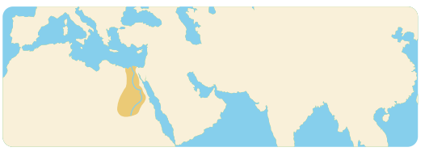
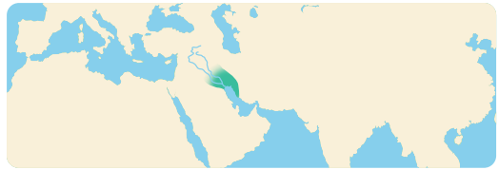
Year 4 | Subject: History | Unit Title: Ancient Civilisations | Unit Title: The Amazon
Knowledge statements: I know that a civilisation is a developed society. I know that civilisations share common features, including cities, inventions, language, writing, hierarchy, leadership, infrastructure, arts and culture, trade and religion. I can recall that ancient civilisations first appeared over 6000 years in, or near, a semi-circular area of land in the Middle East known as the Fertile crescent. I know that Ancient civilisations developed inventions in agriculture, their way of life and city living.
 |  |  |  | We are Historians: To develop chronological knowledge and understanding of world history. To note connections, contrasts and trends in history. To know our knowledge of the past is devised from a range of sources.
Key vocabulary: Civilisation – The developed culture and way of life of a society. Fertile Crescent – The semi-circular area of land where the first ancient civilisations began. Irrigation - The digging of channels to allow water to flow through a field to water crops. Nomadic – A lifestyle involving moving from place to place. Ziggurat – A large pyramid made from mud bricks, with a temple on top. Ancient Sumerians – People who lived in Ancient Sumer, they were the world’s first civilisation. Ancient Egyptians – These were people who lived in ancient Egypt between 3100 and 332 B.C. |  |  | Timeline:
The ancient Egyptian civilisation began on the banks of the Nile, in the Fertile Crescent. Egypt was initially split into Upper Egypt in the south and Lower Egypt in the north.
Ancient Sumer was the very first civilisation. It originated between the Euphrates and Tigris rivers in modern Iraq. Being near a river was important for early civilisations, providing water for drinking and fertile soil for agriculture.

