Slide 1

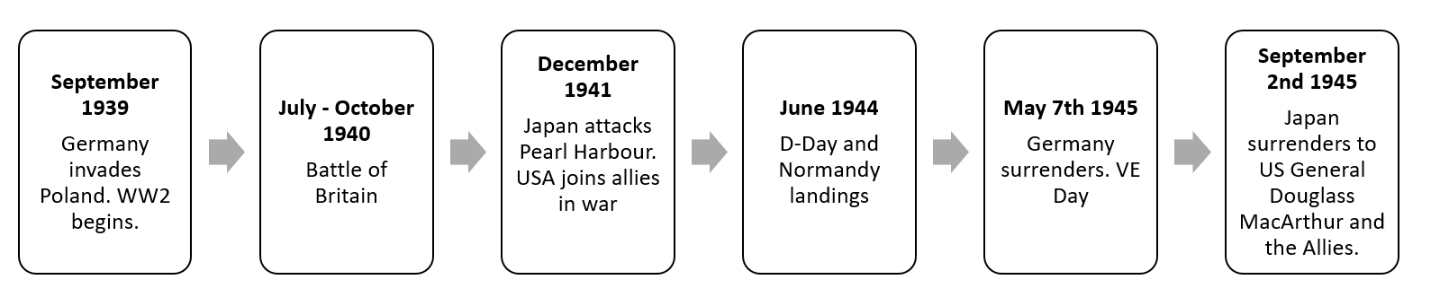
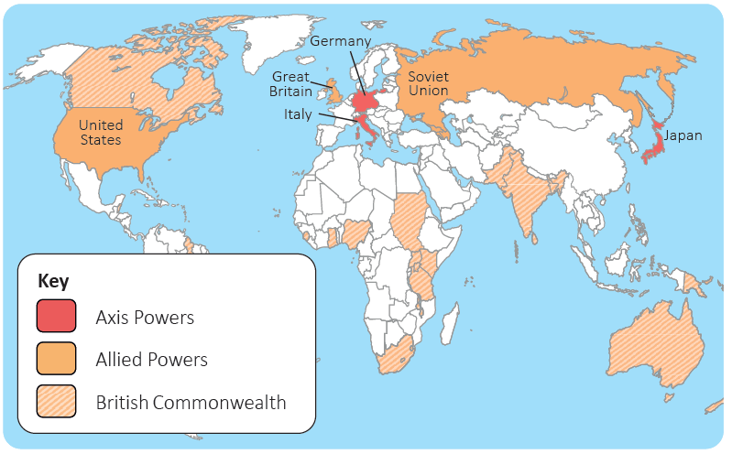
Year 6 | Subject: History | Unit Title: Britain at War 2 | Unit Title: The Amazon
Knowledge statements: I can order and summarise key events during this historical period using timeline. I can describe how Britain had a major influence on the world during World War 2. I can recall key facts about evacuation and rationing. I can discuss the Holocaust and the impact it had on people and has today. I can identify and explain the positive and negative use of propaganda. I can identify the impact of the war on my local area during and after the war
 |  |  |  | We are Historians: We can put historical events in chronological order. We can ask thoughtful questions –why did children need to be evacuated? What was the experience of being an evacuee like? We can think critically – why did World War II start? What were the most significant factors?
Key vocabulary: Evacuee: someone who has had to leave their home to ensure their safety. Black out: to completely block out all forms of light sources. Rationing: only being allowed a certain amount of items. E.g. 1 pint of a milk a day. Air-raid shelter: a building or structure designed to protect people from bombs being dropped. Nazis: a German political party of the twentieth century, led by Adolf Hitler. The Nazis controlled Germany from the early 1930s until the end of World War II. Blitz : an intensive or sudden military attack. Holocaust: destruction or devastation on a mass scale. Fascism: a type of far right government which emerged in the early 20th century. Luftwaffe: the name for the air force of Germany during the Third Reich when Adolf Hitler was in power (between 1933 and 1945.) |  |  | Timeline:

