Slide 1

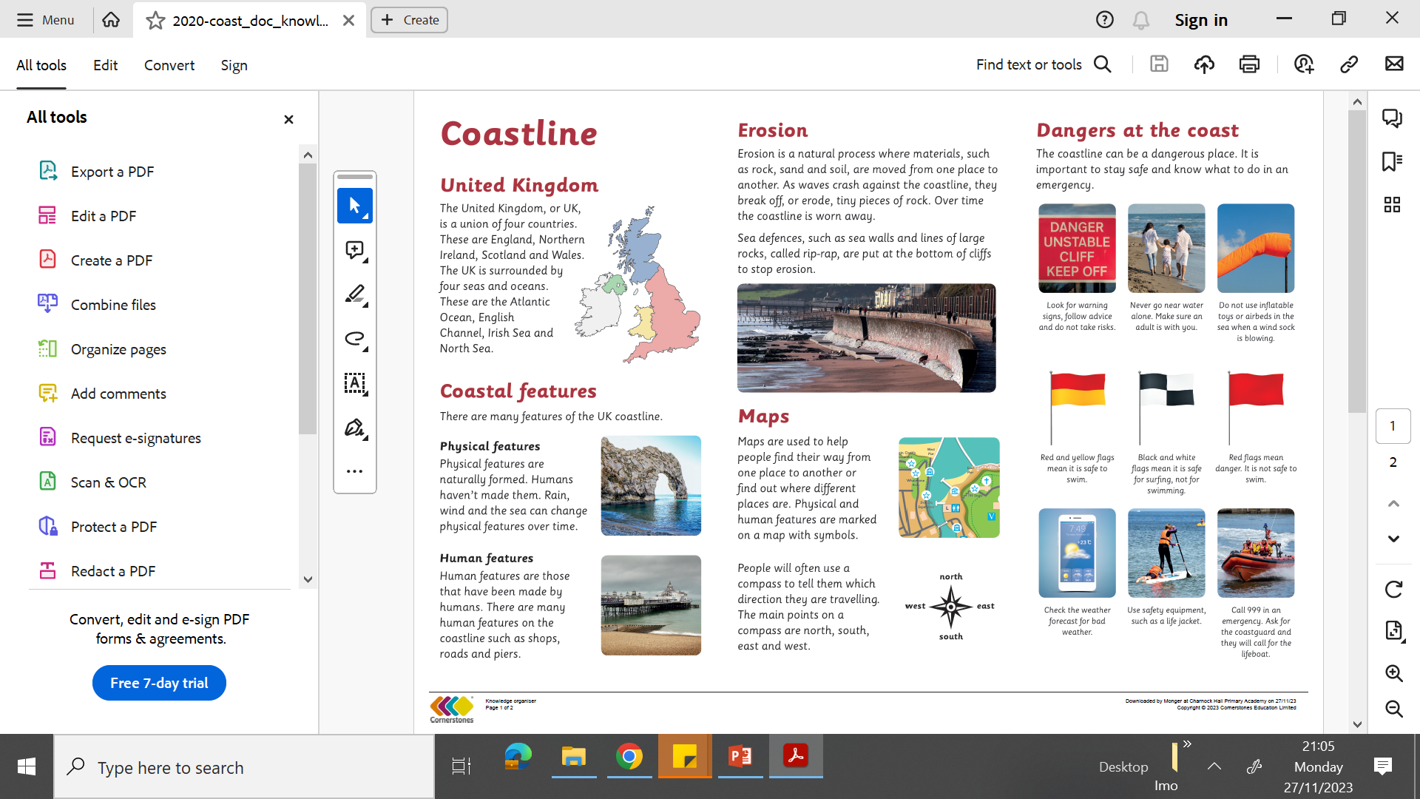
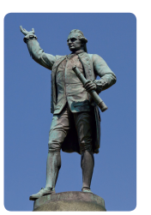
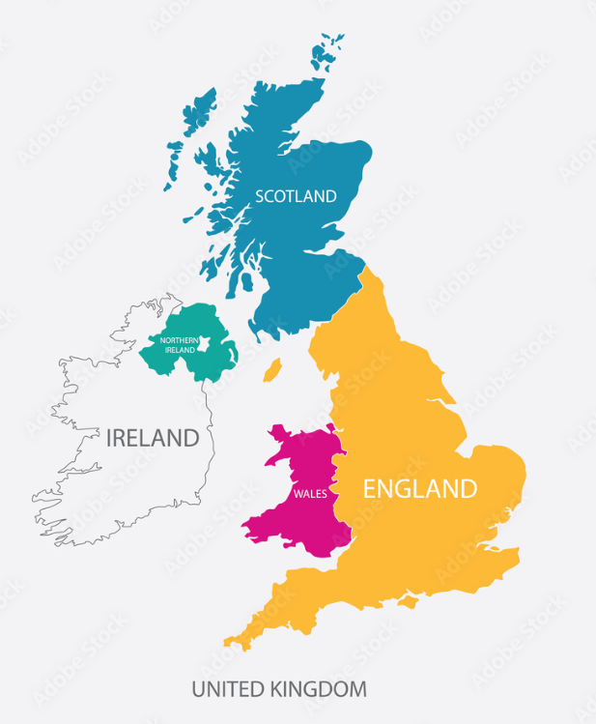
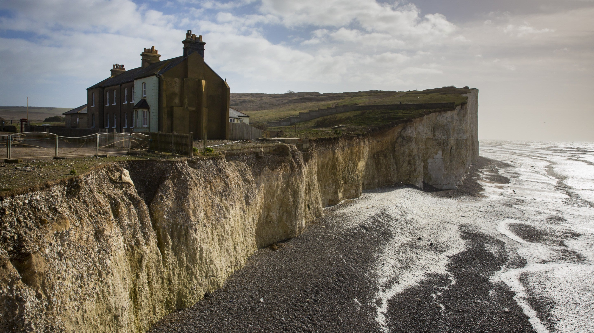
Year 2 | Subject: Geography |  | Unit Title: Coastline | Unit Title: The Amazon
 |  |  |  |  | We are Geographers: We can interpret information from maps, globes, diagrams and photographs. We can communicate geographical information in a variety of ways, including through maps, numerical and quantitative skills and writing at length.
Key Vocabulary: capsize When a shop or boat turns over in the water. coastline The place where the land meets the sea or ocean. compass An instrument used for showing directions. emergency A situation that is urgent or serious and needs urgent help. explorer A person who travels to places to learn about them. feature Something that is part of an area of land. volunteer A person who works without being paid. |  | Captain James Cook Captain James Cook was a famous explorer who lived almost 300 years ago. He was the first person to sail across the world in both directions. |  | Physical Features Physical features are naturally formed so humans haven’t made them. |  | Human Features Human features have been made by humans.
 |  |  |  | Erosion Erosion is a natural process where materials such as rock, sand and soil are moved from one place to another. As waves crash against the coastline , they break off or erode tiny pieces of rock. Over time the coastline is warn away. |  | Map of the United Kingdom
Knowledge statements:
I can understand geographical similarities and differences through studying the human and physical geography of a small area of the United Kingdom (Whitby).
I can use basic geographical vocabulary to refer to key physical features and key human features.
I can use world maps, atlases and globes to identify the United Kingdom.

