Slide 1


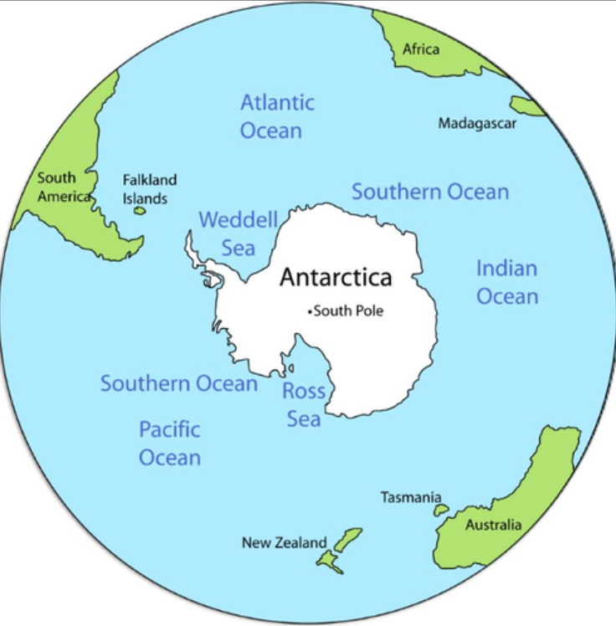
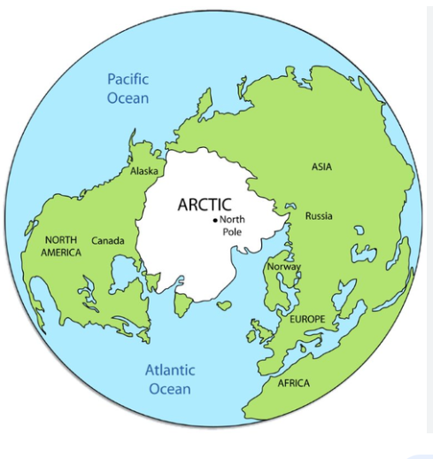
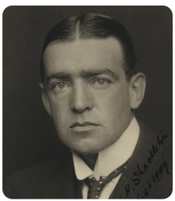
Year 6 | Subject: Geography |  | Unit Title: Frozen Kingdoms
 |  |  |  | We are Geographers: To use the eight points of a compass and compare the locations of counties and continents. To identify where countries are using their latitude and longitude. We can communicate geographical information through drawing maps and writing about polar regions.
Key Vocabulary: Glacier Glaciers are slow - moving masses of flowing ice, formed by the compaction of snow. They can vary in depth from 50m to 1500m. Ice Field Ice fields are large areas of connected glaciers covering flat areas, such as valleys and high plateaus. They are made from compressed and frozen snow. Iceberg Icebergs are chunks if ice that break off from glaciers and ice sheets and float in the sea.
Knowledge Statements:
I can identify the position and significance of latitude, longitude, Equator, Northern Hemisphere, Southern Hemisphere, the Tropics of Cancer and Capricorn, Arctic and Antarctic Circle, the Primer Greenwich Meridian and time zones (including day and night).
I know that Polar regions have long cold winters and temperatures below freezing. The weather can be very windy with little precipitation.
I know Ernest Shackleton (1874 -1922) was a British explorer who led an expedition to walk across Antarctica.
I know that human activities such as burning fossil fuels and deforestation are releasing gases into the atmosphere that are causing the temperature of the Earth to rise and its climate to change.

