Slide 1




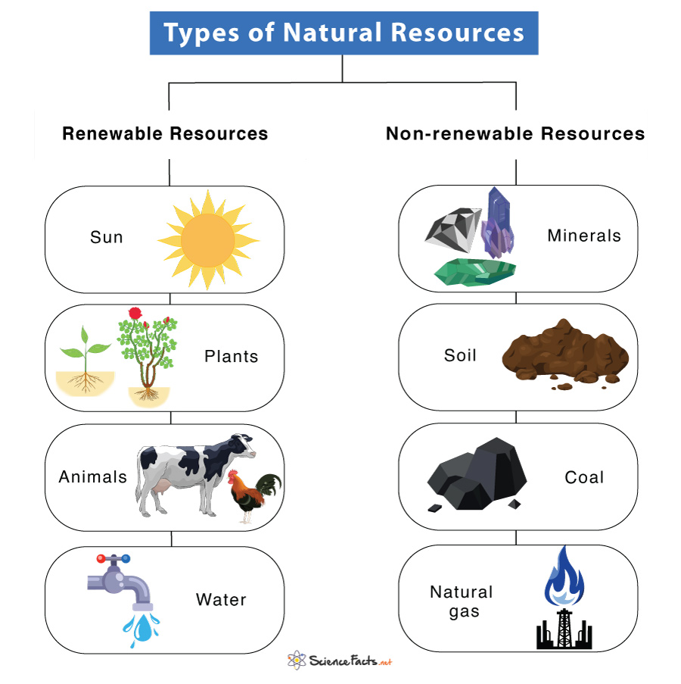
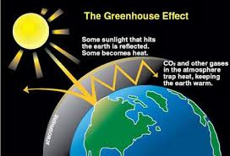

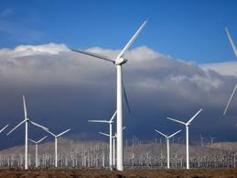
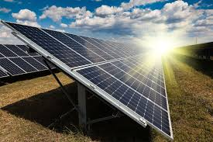
Year 5 | Subject: Geography | Unit Title: Sustainable World | Unit Title: The Amazon
 |  |  |  | We are Geographers: We can interpret information from maps, globes, diagrams and photographs. We can communicate geographical information in a variety of ways, including through maps, numerical and quantitative skills and writing at length.
 |  |  | Key vocabulary: |  | Renewable Energy Energy that comes from sources that won’t run out, like the sun, wind, or water. Solar Power Energy made from the sun. Sustainable Using resources in a way that meets our needs today without stopping future generations from meeting theirs.
 |  |  | Carbon Footprint The amount of carbon dioxide (CO₂) we create through our activities, like travelling or using electricity. Climate Change Long-term changes in the Earth’s temperature and weather patterns. Electricity A form of energy that powers lights, computers, and many machines. Energy Power that we use to move, heat, light, or work things. Energy Efficiency Using less energy to do the same job. Environment The world around us, including air, water, plants, animals, and people.
Knowledge statements:
I can identify and explain how renewable and non-renewable resources are used
I can identify different sources of food, explain why food production is sometimes harmful to the planet and know what sustainable farming is.
I can describe what economic minerals are and explain where they can be found and how we use them.
I can explain what sustainability is and how we can explain how we can globally reduce our carbon footprint including food waste and energy
I can suggest ways in which cities can become more sustainable

