Slide 1


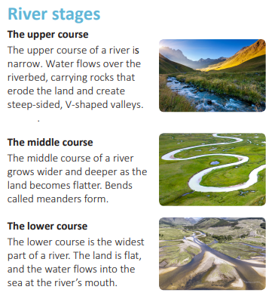
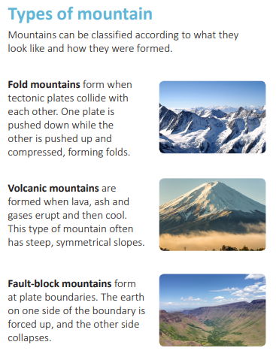
Year: 4 | Subject: Geography | Unit Title: Misty Mountain, Winding River | Unit Title: The Amazon
 |  |  |  | We are Geographers: We can understand and describe the stages of a natural process and the effect it has. We can identify different human and physical features and their purpose in the environment. We can understand the geographical similarities and differences through the study of human and physical geography of a region of the United Kingdom.
Key vocabulary: Delta – A triangular piece of land at the mouth of a river that has formed because of a build up of settlement. Meander – A bend in a river or stream. Oxbow lake - A curved lake that was once a meander in a river. Sediment – Very small pieces of sand, soil and stone that form through the process of erosion. Altitude - The height of an object or point above sea level. Plate boundary – The place where two tectonic plates meet. Erosion – Erosion is the wearing away and removal of rock and soil by means of wind or water. Transportation - Transportation is when rocks and soil that have been dislodged and worn away by erosion are transported in flowing water. Deposition - Deposition happens when flowing water slows down. Eroded rock and soil that have been transported are left behind.
Knowledge statements:
I can understand the geographical similarities and differences through the study of human and physical geography of a region.
I can describe and understand key aspects of physical geography, including rivers, mountains and the water cycle.
I can study and draw conclusions about places and geographical features using a range of geographical resources, including maps, atlases, globes and digital mapping.
River stages
Types of mountain
Mountains can be classified according to what they look like and how they were formed.
The upper course
The upper course of a river is narrow. Water flowers over the riverbed, carrying rocks that erode the land and create steep-sided, V-shaped valleys.
Fold mountains form when tectonic plates collide with each other. One plate is pushed down while the other is pushed up and compressed, forming folds.
The middle course
The middle course of a river grows wider and deeper as the land becomes flatter. Bends called meanders form.
Volcanic mountains are formed when lava, ash and gases erupt and then cool. This type of mountain often has steep, symmetrical slopes.
The lower course
The lower course is the widest part of a river. The land is flat, and the water flows into the sea at the river’s mouth.
Fault-block mountains form at plate boundaries. The earth on one side of the boundary is forced up, and the other side collapses.

