Slide 1

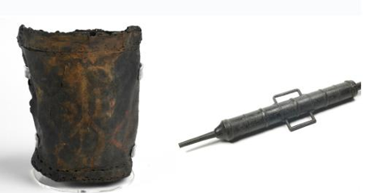
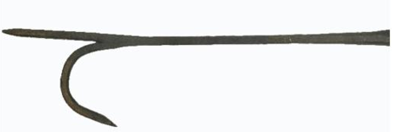
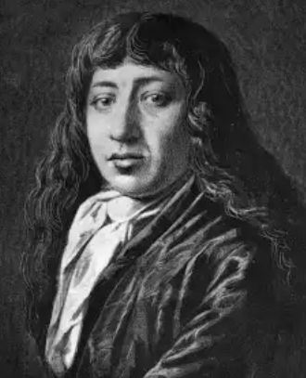
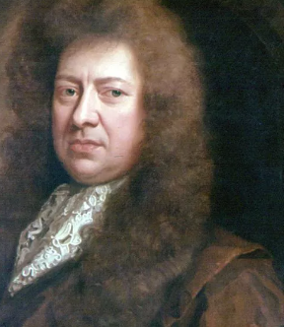
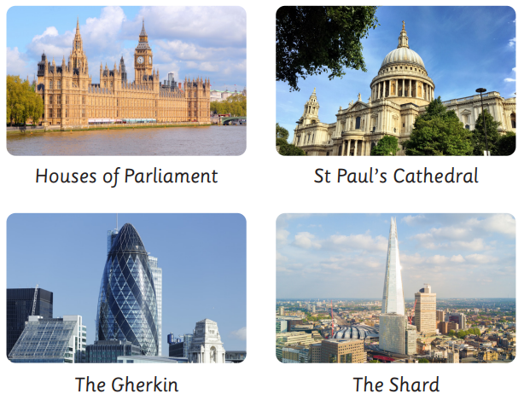
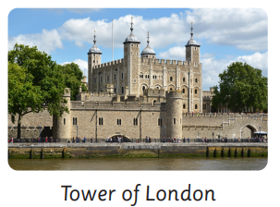
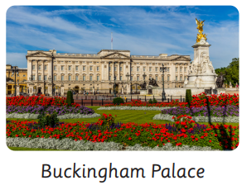
 | Subject: Geography | Unit Title: Bright Lights Big Cities | Unit Title: The Amazon
Knowledge statements: I know London is the capital city of England. I know the Great Fire of London happened in 1666 in London. I know human features are man made features and physical are naturally formed. I can identify human and physical features
 |  |  |  | We are Geographers: We can use world maps, atlases and globes to identify different countries. We can spot and sort human and physical features. We can recognise landmarks using marks and aerial photos.
Key vocabulary: Capital City - A city that is home to the government and ruler of a country. Human features - Human-made features, such as buildings, roads and bridges. Physical features - Naturally-formed features, such as cliffs, rivers and forests. Settlement – A place where people live and work. Country – A large area of land that has its own government. |  |  | Water bucket Fire squirt Fire Hook
 |  |  | Samuel Pepys wrote a fire hand account of the Great Fire of London in his diary. |  | Thomas Farriner was the baker of King Charles II. His Bakery on Pudding Lane is where the Great Fire of London Started.

